Slide 1
Week 2
Introduction to Sampled Data
Audio Input/Output
Concurrency
Bonus topic: Profiling
Notes:
Things to improve:
Confusion about copying into/out of OS-provided buffers

Slide 2
Overview
Over this week and the next, we’ll tour 1-d Sensing
We will start with 1-dimensional sensing sources as they are simpler!
Audio
Gyroscope
Accelerometer
GPS
Compass
Combined “Meta-sensor” for orientation
We’ll take a brief look at the basics of dealing with sampled data
Once we’re done with 1-d, we’ll move on to 2-d! (Images)

Slide 3
Overview
We will also pick up a few more CS concepts
Concurrency (Doing multiple things at once)
Necessary not only for speed, but for sensing at all
Can fit in nicely with the “event-based” architecture of apps
Both thread-based and closure (or lambda)-based
Profiling (Performance testing)
Figuring out where your application is spending all its compute time)
Don’t optimize before you figure out what needs it!

Slide 4
Phone Logistics
We only have 20 phones, and we have ~30 students
There are more than 20 of you all
Rather than compete for limited resources, let’s team up!
Group yourselves into teams of 2 to share phones
These don’t necessarily need to be your final project groups
If last year was anything to go by, they usually will be!
The phones will be returned to Microsoft
So please don’t launch it in a rocket as part of your final project

Slide 5
Sampled Data
Why is understanding Sampled Data important?
Because we’ll be dealing with it all quarter!
It’s important to understand basic mistakes that can be made
There are entire courses dedicated to sampled timeseries (EE 518)
We’ll touch on a few guidelines to help you design your projects better

Slide 6
Sampled Data
Physical processes are inherently continuous
To process with computers, we must digitize it!
This digitizing process occurs in time and amplitude:
Time: Sampling
Amplitude: Quantization

Slide 7
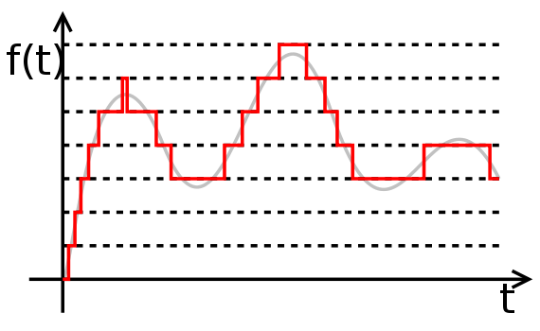
Sampled Data
Quantization
Introduces error in amplitude signal
Error reduced through more “bits per sample”
Most ADCs 16 bits, considered “good enough”
Internally, our phone uses
32 bits to process, 16 bits
to capture
Sufficient for most uses
Not for others!

Slide 8
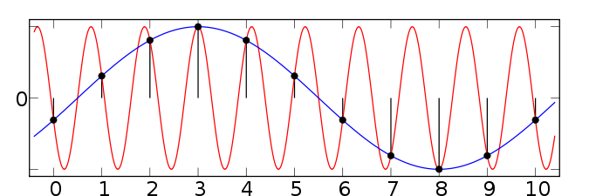
Sampled Data
Sampling
Introduces errors through ‘aliasing’
Limits the range of frequencies able to be accurately captured
Root of most common mistakes with sampled data

Slide 9
Sampled Data
Rules of Thumb
If capturing an X Hz signal, need to sample at a rate of at least 2X Hz
Changing samplerates is complicated, don’t just drop samples
Speech:
Majority of necessary energy in speech is located < 8000Hz
Phones (for speech) typically capture at 16KHz
Good enough for speech, not music!
<Your Signal Type Here>:
Be aware both of your resolution in Amplitude and Time!
This holds for sensors beyond just audio
Gyro, Accelerometer, even Camera data needs this math

Slide 10
Example: Stereo Audio
Audio is laid out pretty much how you’d expect
When you have multiple channels, it’s interleaved
Each sample is a 32-bit floating-point number
Input on our phones is mono, 1 channel
Output is stereo, 2 channels!
To output recorded audio, we must output each sample twice
This creates interleaved stereo data, with mirrored channels

Slide 11
Arrays in C++
Created with new (We’ll use new instead of malloc)
float * data = new float[numSamples];
Accessed with the square brackets
for( int i=0; i<numSamples; ++i ) {
data[i] = sin(2*3.14159*i);
}
Cleaned up with delete
delete data;

Slide 12
Constructors, Destructors
Speaking of creating and deleting arrays…
Classes get created and destroyed as well
If you need to manually destroy a C++ object, here’s how
In C++, we define this with a Destructor
public ref class Filter sealed
{
public:
Filter( unsigned int numChannels, unsigned int samplerate );
virtual ~Filter();
...
}
In C#, we call this via the Dispose member
Filter filt = new Filter(2, 48000);
...
filt.Dispose();

Slide 13
Audio Input/Output
Three interfaces to Audio Hardware in WP8
XNA
XAudio2
WASAPI
Each has pros and cons, each has its own niche
Only XNA is backward-compatible with WP7
All three can be used on the Desktop/Surface

Slide 14
Audio Input/Output
XNA
+ Easy to use. (I mean REALLY easy)
High Latency (100ms minimum)
Low sampling rate (16KHz)
XAudio2
+ Flowgraph representation, great for quickly hooking up chains of effects
No recording interface
Designed more for games than general purpose use
WASAPI
+ Lowest latency, most general
By far the most verbose

Slide 15
XNA Sample
To record and play back audio, we need less than 20 lines of code
We will start by looking at documentation
The namespace we want is: Microsoft.Xna.Framework.Audio
Inside, we find conspicuous classes such as
Microphone
DynamicSoundEffectInstance
We also find tutorials, as well as code on how to do this on the desktop!
When searching documentation, because the desktop and phone APIs are so closely linked, be sure to check at the bottom to verify it’s phone compatible and not desktop-only

Slide 16
XNA Sample
Looking closer at those two classes
Microsoft.Xna.Framework.Audio.Microphone members of note:
BufferReady event called when a buffer of audio is ready
BufferDuration property sets the duration of said buffer
Start() function does exactly what it sounds like
GetData( byte[] ) function stores a ready buffer into the argument
Microsoft.Xna.Framework.Audio.DynamicSoundEffectInstance
SubmitBuffer( byte[] ) function queues the given bytes for playback
Play() function plays all queued bytes that have been queued
If this were the whole story, everything could be done in ~13 lines
Hint: It’s not the whole story

Slide 17
XNA Sample
using Microsoft.Xna.Framework.Audio;
...
// We’ll instantiate some of these in MainPage()
private Microphone audioIn = Microphone.Default;
private DynamicSoundEffectInstance audioOut = null;
private byte[] audioBuffer = null;
public MainPage()
{
...
// Add in the event handler for when a new buffer of audio is available
audioIn.BufferReady += new EventHandler<EventArgs>(Microphone_BufferReady);
// XNA is limited to 100ms latency. :(
audioIn.BufferDuration = TimeSpan.FromMilliseconds(100);
// Create a buffer of the appropriate length
int bufferLen = audioIn.GetSampleSizeInBytes(audioIn.BufferDuration);
audioBuffer = new byte[bufferLen];
// Create our audio out interface with the same samplerate and channels of the audio input
// We couldn't create this above because we needed to get audioIn.SampleRate
audioOut = new DynamicSoundEffectInstance(audioIn.SampleRate, AudioChannels.Mono);
// Start recording and playing
audioIn.Start();
audioOut.Play();
}

Slide 18
XNA Sample
// Add in the event handler for when a new buffer of audio is available
audioIn.BufferReady += new EventHandler<EventArgs>(Microphone_BufferReady);
This line does a lot, let’s break it down
The audioIn object has an “Event” inside it that is triggered regularly
This “Event” (BufferReady) notifies us when a buffer is ready for reading
“Events” are really lists of functions to be called
We are adding a new function to this list: Microphone_BufferReady
We will define the function Microphone_BufferReady on the next slide

Slide 19
XNA Sample
private void Microphone_BufferReady(object sender, EventArgs e)
{
audioIn.GetData(audioBuffer);
audioOut.SubmitBuffer(audioBuffer);
}
That’s it!
Grab the data from the microphone (audioIn.GetData)
Push it out onto the speaker (audioOut.SubmitBuffer)
….well, almost
We have one final nagging question

Slide 20
Who Initiates Events?
Who calls our Microphone_BufferReady object?
The answer, unsurprisingly, is the other code we have to write
XNA events are triggered by the Framework, but:
We must routinely call FrameworkDispatcher.update() to trigger events
But we can’t block the UI from responding with a while loop
We have to call this function repeatedly in parallel
Enter the DispatcherTimer class from System.Windows.Threading
Calls a function every X milliseconds

Slide 21
DispatcherTimer
Very simple to use
DispatcherTimer timer = new DispatcherTimer();
// Run it a little faster than our buffer updates
timer.Interval = TimeSpan.FromMilliseconds(80);
timer.Tick += OnTimerTick;
timer.Start();
Calls the function OnTimerTick every 80ms
Now we’re almost set, need to put these together:
void OnTimerTick(object sender, EventArgs args)
{
FrameworkDispatcher.Update();
}

Slide 22
XNA Audio Debrief
We have just done the following:
Opened interfaces for Audio Input/Output
Created a Timer to routinely poke the XNA Framework
This generates the events that call our “Microphone Ready” events
Defined a “Microphone Ready” event to grab audio data
Which we then just push right back out to the speaker
So this was (relatively) easy, why don’t we always do it like this?
There are two big problems with this method

Slide 23
XNA Audio Debrief
The capture parameters are lacking
We’ve touched on this before, 16KHz samplerate, 100ms latency
The audio format is not easily processed
The datatype itself is not very friendly
The audio is a 16-bit stream, but is stored as an 8-bit array (byte[])
There are ways to combine every two byte values together
They are not pretty, and they are not efficient
Even something as simple as applying a 2x gain term or adding two signals together does not work out like you would want it to
This is the real problem for us, as we want to do processing!

Slide 24
XNA Audio Demo

Slide 25
Brief Git Interlude
Let’s talk a little more about why Git is useful
Branches
More advanced ways to interact with Git
Inherently a command-line program
Github for Windows just a fancy UI that sits on top
Advanced example: pulling from another remote
Git supports multiple “remotes”
origin being the default remote for all operations
Setting your personal fork as the default remote is usually what you want
But what if you want to pull changes I have made in the template?

Slide 26
Brief Git Interlude
Commandline to the rescue!
Right-click on repository, select “Open Shell Here”
git remote add upstream git@github.com:EE590-Spring2014/Homework1.git
git pull upstream master
This adds a new remote called upstream, and pulls the master branch
This incorporates commits from upstream’s master into your local copy
Other useful git commands:
git status
git commit –a
git push
git log
git diff

Slide 27
WASAPI
Let’s dive right in, there’s a lot we have to do
As said before, WASAPI is quite verbose
Will require ~10 function calls just to open Audio Input/Output
Has both an event-based and manually polled interface
Allows us to create a “Microphone Ready” event similar to XNA
Lots of stuff can go wrong, so error handling is a must to debug problems
Same code is used on Windows Desktop and Surface
Some features unavailable on phone, make sure to check when looking at MSDN documentation!
Finally, remember WASAPI is C++, so you’ll be doing this in a C++ module

Slide 28
WASAPI
Class Overview
WAVEFORMATEX
This structure has been around for decades
Describes an audio format (samplerate, channels, bitdepth, etc…)
IAudioClient2
Controls Audio specifications (Via WAVEFORMATEX)
Also controls buffer length
We’ll call these objects inputDevice, outputDevice
IAudioRenderClient, IAudioCaptureClient
Created from IAudioClient2
Provides the read/write interface for reading/writing audio
We’ll call these objects inputClient, outputClient

Slide 29
WASAPI (Input) Setup
We’ll start with IAudioClient2
First, we need to create the interface:
IAudioClient2 *inputDevice;
auto deviceId = GetDefaultAudioCaptureId(AudioDeviceRole::Default);
auto classId = __uuidof(IAudioClient2);
ActivateAudioInterface( deviceId, classId, (void **)&inputDevice );
This activates the default capture device
auto is a special variable type that matches the right-hand side
The C++ equivalent to C#’s var
The deviceId and classId parameters tell ActivateAudioInterface what exactly we are trying to activate
If you don’t understand (void **)&inputDevice brush up on pointers

Slide 30
WASAPI (Input) Setup
Next, we get the native audio format of the input
On Desktop/Surface, we can specify different formats and the OS will convert for us, but on the phone, we have to play by its rules
WAVEFORMATEX *inputFormat
inputDevice->GetMixFormat(&inputFormat);
Inspecting inputFormat we find the data members:
nChannels, a short, containing the number of channels
nSamplesPerSec, an int, containing the samplerate
wBitsPerSample, a short, containing the bitdepth
WP8 captures and plays back at 48KHz, 32-bits
It captures in mono, and plays back in stereo

Slide 31
WASAPI (Input) Setup
Next, we initialize inputDevice with that format
This function can fail if we pass it an invalid format
unsigned int flags = AUDCLNT_STREAMFLAGS_EVENTCALLBACK;
auto mode = AUDCLNT_SHAREMODE_SHARED;
inputDevice->Initialize( mode, flags, 0, 0, inputFormat, NULL );
The flags parameter enables Event mode
This means it’s going to notify us somehow that a buffer is ready
The mode parameter enables Shared mode
Shared mode means we share the audio device with other apps
Exclusive mode is not available on WP8, but is available on the desktop
Exclusive mode allows for even lower latency (<10 milliseconds)

Slide 32
WASAPI (Input) Setup
Next, we use this initialized device to get the client
The Client is the object we will use to read data from the microphone
IAudioCaptureClient *inputClient;
auto classId = __uuidof(IAudioCaptureClient);
inputDevice->GetService(classId, (void**)&inputClient);
Now just one more piece of setup
We have to create the C++ “Event” that will signal a ready buffer
audioInEvent = CreateEventEx(NULL, NULL, 0, EVENT_ALL_ACCESS);
inputDevice->SetEventHandle(audioInEvent);

Slide 33
WASAPI (Input) Setup
Create inputDevice via ActivateAudioInterface()
Get audio format: inputDevice->GetMixFormat()
Initialize inputDevice for event-based recording
Create inputClient to actually read the data in
Create audioInEvent, a C++ event

Slide 34
Events: C++ vs. C#
With Microsoft APIs, C# Events are lists of functions, whereas C++ Events are binary semaphores
Binary semaphores can signal either “ready” or “not ready”
In C# we wait to be called by some external force
In the XNA example, this was the timer, constantly calling update()
In C++, we (as usual) must take a lower-level view
Internally, Timer is forking off a separate thread that has a while loop
This thread sleeps until some condition is met (Timer expired)
Once it wakes up, it does its business, calls its functions, then sleeps again
C++ Events are these conditions that allow the thread to wake up

Slide 35
Threads
Definition:
“A method of introducing timing-dependent bugs that are hardware and platform dependent, that never happen the same way twice, and that only appear after deployment and never in a testing environment.”
Graphically:
Main Thread (Thread #0)
Thread #1
Thread #3
Thread #2
Execution Time

Slide 36
Threads ∩ Events
We will create a thread that sleeps until an event
The key function here is WaitForSingleObjectEx
while( true )
{
if( WaitForSingleObjectEx(audioInEvent, INFINITE, FALSE) == WAIT_OBJECT_0 )
{
...
}
}
WaitForSingleObjectEx does all the hard work
It sleeps until the event stored in the object audioInEvent is triggered
We then know we have audio data waiting for us in the buffer

Slide 37
WASAPI (Input) Reading
We know when to read audio, now let’s learn how
If you remember, this is where that variable inputClient comes in
We notice inputClient has a function GetBuffer:
unsigned char * rawData;
unsigned int numSamples;
unsigned long flags;
inputClient->GetBuffer( &rawData, &numSamples, &flags, NULL, NULL );
This method returns values in its parameters
rawData becomes a pointer to the audio buffer
numSamples is filled with the number of samples ready to be read
flags is filled with some pieces of information

Slide 38
WASAPI (Input) Reading
Notes regarding these parameters
rawData
It is an array of 8-bit unsigned chars, yet it holds 32-bit float samples
In C++, to re-interpret the data as 32-bit floats, we just typecast
We must release this buffer as soon as possible:
inputClient->ReleaseBuffer( numSamples );
numSamples
On WP8, seems to always be the minimum value of 480 samples
At 48KHz recording, this means we get 10ms chunks at once
flags
On WP8, this can contain only two different flags:
AUDCLNT_BUFFERFLAGS_DATA_DISCONTINUITY
AUDCLNT_BUFFERFLAGS_TIMESTAMP_ERROR

Slide 39
WASAPI (Output) Setup
The same exact steps as for Input!
Huzzah! We can copy paste most of the code above
Just remember to change inputClient to outputClient, etc
ActivateAudioInterface to get outputDevice
GetMixFormat to find the output format
Initialize to open outputDevice with that format
GetService to get outputClient
If you are using event-based output, you must:
CreateEventEx to create the Event handle
SetEventHandle to link that event handle to the outputClient

Slide 40
WASAPI (Output) Writing
Writing is slightly more involved than reading
The output buffer is not the same length as the input
The output buffer does not play until it is full
When you write into the output buffer, you must adjust how much you write to account for the previously written audio that hasn’t played yet
This audio you have to skip over is called “padding”
Use outputDevice->GetCurrentPadding to retrieve it
Note that you can only write BufferLength – Padding samples!
Audio Buffer
Previously
Written
Padding
Writeable Samples

Slide 41
WASAPI (Output) Writing
First, we figure out the padding
unsigned int padding = 0;
outputDevice->GetCurrentPadding(&padding);
After getting numSamplesToWrite, we get a buffer
unsigned char * outputBuff;
outputClient->GetBuffer( numSamplesToWrite, &outputBuff );
We copy samples into outputBuff, then release!
outputClient->ReleaseBuffer( numSamplesToWrite, 0 );

Slide 42
WASAPI Debrief
This is a lot of API to take in at once
If you feel like you’ve just had a massive amount of data dumped on you, that’s because you’ve just had a massive amount of data dumped on you
Luckily, this is all just the boring stuff you write once
After this, everything gets more interesting!
A few more questions to be answered though:
How do I start up a thread ? How do I then shut it down?
What is something cool I can do with my audio?
What on earth is this homework going to look like?

Slide 43
Thread Creation
To create a thread, we use ThreadPool::RunAsync
Takes in a WorkItemHandler, a special function to run in another thread
You wrap your function in the WorkItemHandler constructor
ThreadPool::RunAsync( ref new WorkItemHandler(this,
&myClass::audioThread) );
This will start a thread, running the this->audioThread function
void myClass::audioThread( IAsyncAction^ operation ) {
while( true ) {
...
}
}

Slide 44
Thread Cleanup
Once a thread is running, it returns, or you kill it
Since we have a while( true ) loop, it could be a while before it returns
The return value of ThreadPool::RunAsync is useful
audioThreadHandle = ThreadPool::RunAsync( ... );
This handle can stop the thread:
audioThreadHandle->Cancel();
audioThreadHandle->Close();
This handle allows us to gracefully kill a thread
See the CppThread example for more on this

Slide 45
Audio Processing
Lots of space to explore in here
Filtering
If you don’t know how to do it, go take EE 341
Analysis
If you don’t know how to do it, go take EE 518
Synthesis
Play around with different ideas, and see what sounds good!
For today, we’re going to stick with Analysis
Specifically, the Fourier Transform

Slide 46
Audio Processing
The Fourier Transform (FT) converts a timeseries into a frequency spectrum
We can find the magnitude and phase of every frequency in the signal
Extremely useful, not just for signal junkies but also physicists, mathematicians, astronomers, etc…
We’re going to hook up FFTW (The Fastest Fourier Transform in the West), a well-known FT library, to do the heavy numerical lifting for us

Slide 47
Linking in FFTW
The HW2 template comes with a C++ component
Example usage is shown in the sample code, see “FFTWSample”
This C++ component will allow you to perform 1-d Fourier Transforms
This is a “pure” C++ component; you can’t use it from C#
This because we haven’t discussed passing arrays C#←→ C++ (yet)
Some documentation is provided in the .h file
Trickiest part is probably connecting the C++ component to the rest of your project

Slide 48
Misc. Info for HW 2
WASAPI code is added to your C++ component through libraries and headers, not References
It’s C++ code, so we have to add it to the list of libraries in the Project
We need the library phoneaudioses.lib
We also need to #include audioclient.h and phoneaudioclient.h
You cannot use C++ arrays in functions C# can see
That means things like float *, std::vector<float> *, etc. can be used, but they must be private or protected in C++/CX class definitions

Slide 49
Misc. Info for HW 2
FFTW returns arrays of type fftwf_complex
Each element is itself a 2-element array:
The first sub-element is the real part, the next is the imaginary part
You must enable the “Microphone Capability” before you can open the Microphone for input
To do this, double-click on WMAppManifest.xml
Click the “Capabilities” tab
Scroll down to ID_CAP_MICROPHONE, and ensure it is checked

Slide 50
Profiling
This is the bonus topic!
I know it feels like you’re drinking from a fire hose, but if we made it this far, you all rock!
Profiling is the first line of defense against slow code
It allows us to find out which functions take the most time
It works on C# and C++ code!
It can run on the emulator or the device, but the device is recommended
It’s easy to run, you launch it inside of VS

Slide 51
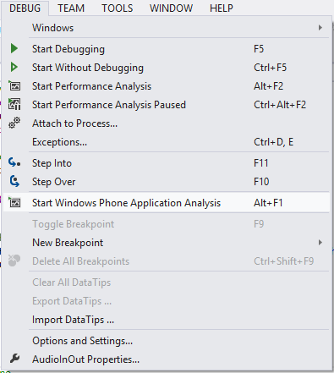
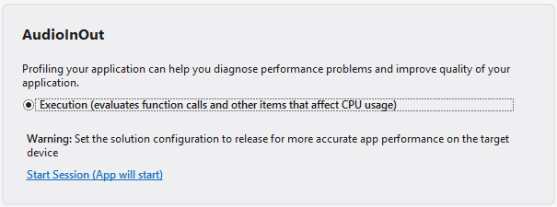
Profiling
To profile your project:
DEBUG->”Start Windows Phone Application Analysis”
Also available via ALT+F1
Launches the profiler interface
Runs your application normally
Collects function call statistics

Slide 52
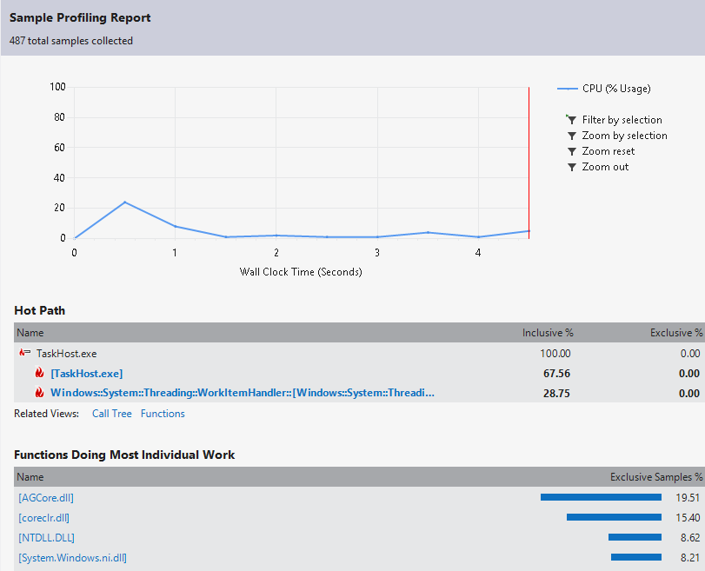
Profiling

Slide 53
Live Profiler Demo

